Slide 1

Cybersecurity virtual internship
Cybersecurity virtual internship
by
L. Ganesh
Roll No. 224G1A3324
Department of Computer Science and Engineering (Data Science)
Srinivasa Ramanujan Institute of Technology
(Affiliated to JNTUA & Approved by AICTE) (Accredited by NAAC with ‘A’ Grade & Accredited by NBA (EEE, ECE & CSE)
Rotarypuram Village, B K Samudram Mandal, Ananthapuramu – 515701.
2024 - 2025
DEPT.OF CSE(AI&ML)
Srinivasa Ramanujan Institute of Technology

Slide 2
Cybersecurity virtual internship
Contents
Course Objectives
Introduction
Cyber Attack Techniques
Network Security Technologies
Modules
Learning outcomes
GitHub link
Certificate
224G1A3324
DEPT.OF CSE(AI&ML)
Srinivasa Ramanujan Institute of Technology
2

Slide 3
Cybersecurity virtual internship
Course Objectives
Understanding and Implementing Network Security Measures: Gain knowledge of essential network security concepts such as firewall configuration, intrusion detection systems (IDS), and virtual private networks (VPN). Develop practical skills in configuring and managing Palo Alto Networks firewalls to protect enterprise environments from cyber threats.
Identifying and Mitigating Cybersecurity Threats: Learn to identify various cybersecurity threats, vulnerabilities, and attack vectors. Use Palo Alto's security tools to conduct risk assessments, implement threat prevention measures, and develop protocols for incident response and data protection.
224G1A3324
DEPT.OF CSE(AI&ML)
Srinivasa Ramanujan Institute of Technology
3

Slide 4
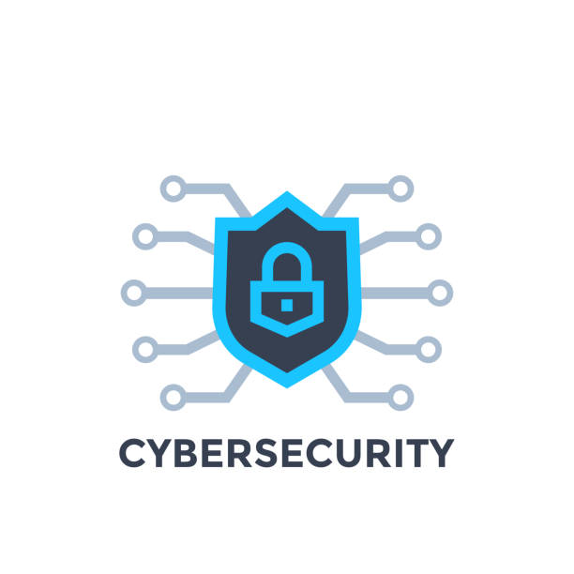
Cybersecurity virtual internship
Introduction
Palo Alto Networks is recognized as a global leader, offering advanced cybersecurity solutions for a range of industries.
The company provides next-generation firewalls, cloud security, advanced threat intelligence, and endpoint protection.
Their solutions are designed to safeguard networks, data centers, and cloud environments from increasingly sophisticated cyber threats.
Palo Alto's platform integrates AI-powered threat detection, real-time monitoring, and automated response systems to proactively mitigate risks.
Palo Alto's firewalls are known for deep packet inspection, application awareness, and the prevention of malware, ransomware, and network intrusions.
Their security solutions are scalable, catering to the needs of businesses, governments, and service providers
By integrating automation and analytics, Palo Alto helps organizations maintain strong defenses, reduce attack surfaces, and adapt to evolving cyber threats.
224G1A3324
DEPT.OF CSE(AI&ML)
Srinivasa Ramanujan Institute of Technology
4

Slide 5

Cybersecurity virtual internship
Cyber Attack Techniques
Malware and Exploits
Malware and exploits are integral to modern cyber-attacks. Attackers leverage a variety of malware types, including viruses, worms, Trojans, and ransomware, to gain unauthorized access and control over systems. Understanding the relationship between vulnerabilities and exploits is crucial for effective defense.
Spamming and Phishing
Spamming and phishing are common techniques used by attackers to deliver malware and exploits. These methods often involve deceiving users into clicking on malicious links or opening infected attachments, compromising endpoint security and providing a foothold for further attacks.
Advanced Persistent Threats
Advanced Persistent Threats (APTs) are sophisticated, targeted attacks that often leverage a combination of social engineering, malware, and other techniques to infiltrate and maintain a persistent presence within an organization's network, to steal sensitive data or disrupt operations.
224G1A3324
DEPT.OF CSE(AI&ML)
Srinivasa Ramanujan Institute of Technology
5

Slide 6
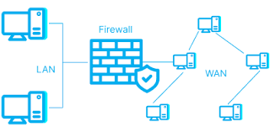
Cybersecurity virtual internship
Network Security Technology
Firewalls
Firewalls are a fundamental network security technology, designed to prevent unauthorized access to or from a private network. They can be implemented as hardware, software, or a combination of both, and employ various filtering techniques to control the flow of network traffic.
Intrusion Detection and Prevention
Intrusion Detection Systems (IDS) and Intrusion Prevention Systems (IPS) monitor network traffic for signs of malicious activity, alerting administrators and, in the case of IPS, actively blocking or mitigating detected threats.
Virtual Private Networks (VPNs)
VPNs create secure, encrypted connections between devices and networks, allowing remote users to access corporate resources securely over the internet. This technology is essential for protecting data and ensuring privacy in today's distributed work environments.
224G1A3324
DEPT.OF CSE(AI&ML)
Srinivasa Ramanujan Institute of Technology
6

Slide 7
Cybersecurity virtual internship
Modules
Modules1: Network Security Fundamentals
1. Network Security Overview
The Network Security Fundamentals course covers the basics of securing modern networks. Key topics include global network architecture, connected devices, IP addressing, subnetting, and networking models like TCP/IP and OSI. It explains how data packets travel through networks via encapsulation and routing processes.
2. Endpoint Security and Threat Prevention
The course highlights endpoint security, focusing on threats like malware, viruses, ransomware, and phishing. It teaches practical strategies for protecting home networks and critical infrastructure, emphasizing preventive measures to secure devices and detect vulnerabilities.
3. Palo Alto Networks Solutions
The final module introduces Palo Alto Networks Strata, featuring next-gen firewalls, intrusion prevention systems (IPS), and network traffic monitoring tools. These solutions help protect networks from advanced cyber threats, offering comprehensive security for both small and large-scale networks.
224G1A3324
DEPT.OF CSE(AI&ML)
Srinivasa Ramanujan Institute of Technology
7

Slide 8
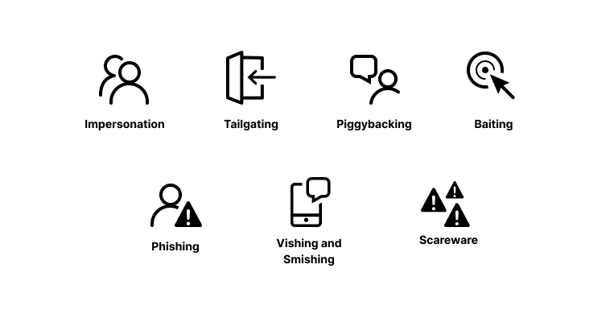
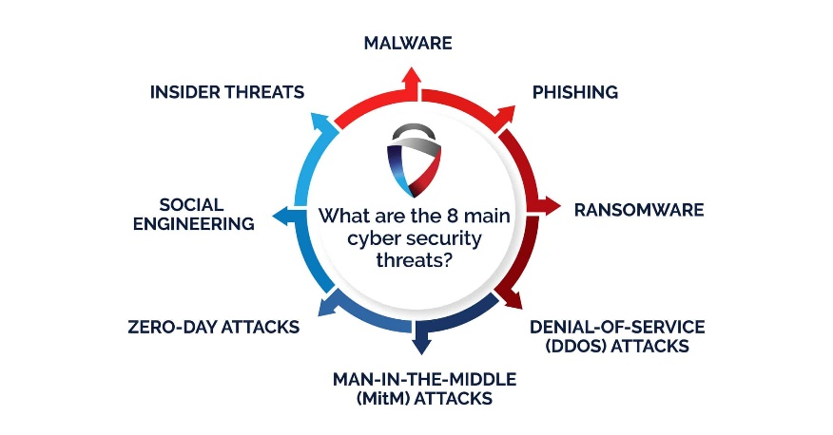
Cybersecurity virtual internship
Modules
Module 2: Cybersecurity Fundamentals
The Cybersecurity Fundamentals course provides a comprehensive overview of today's cybersecurity landscape and the evolving nature of cyber threats. It covers current attack methods, such as phishing and malware, and highlights defense strategies to protect against them. Learners are introduced to risks associated with public Wi-Fi and practical protection measures. The course also explores modern security models, including perimeter-based security and the Zero Trust model, which offer frameworks for stronger network defense. It concludes with an overview of Palo Alto Networks' prevention architecture, focusing on essential tools and capabilities needed to prevent successful cyberattacks.
224G1A3324
DEPT.OF CSE(AI&ML)
Srinivasa Ramanujan Institute of Technology
8

Slide 9
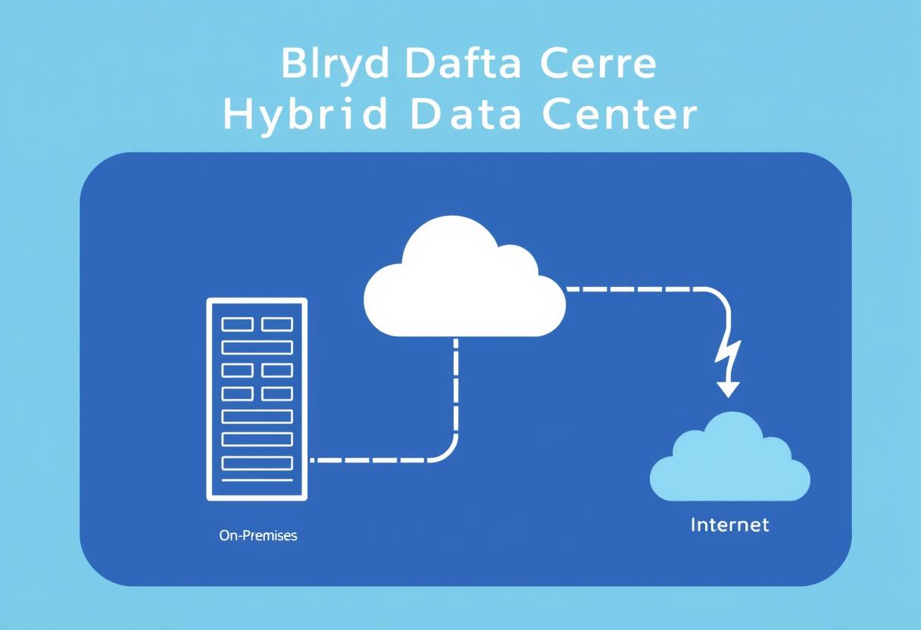
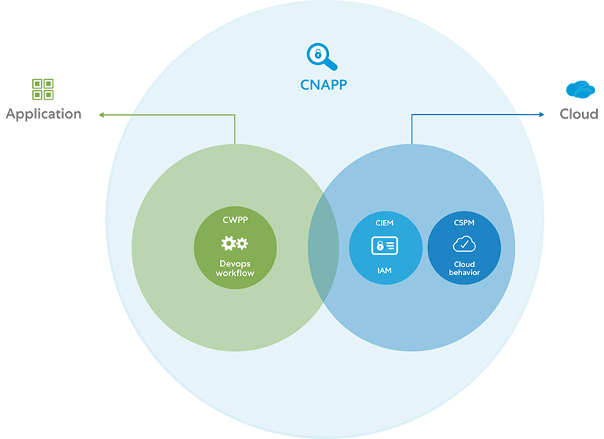
Cybersecurity virtual internship
Modules
Module 3: Cloud Security Fundamentals
The Cloud Security Fundamentals course covers essential technologies in cloud computing, such as virtual machines, containers, and the CI/CD pipeline, focusing on the role of development operations teams. It provides an overview of cloud computing models, shared responsibility, best practices, and hybrid cloud environments. The course explains how organizations adopt cloud technologies and utilize cloud-native application protection platforms (CNAPP) to ensure comprehensive security and compliance for cloud-native applications. It also highlights the Prisma Cloud platform, which detects and prevents security risks using CNAPP for applications in both development and production environments.
224G1A3324
DEPT.OF CSE(AI&ML)
Srinivasa Ramanujan Institute of Technology
9

Slide 10
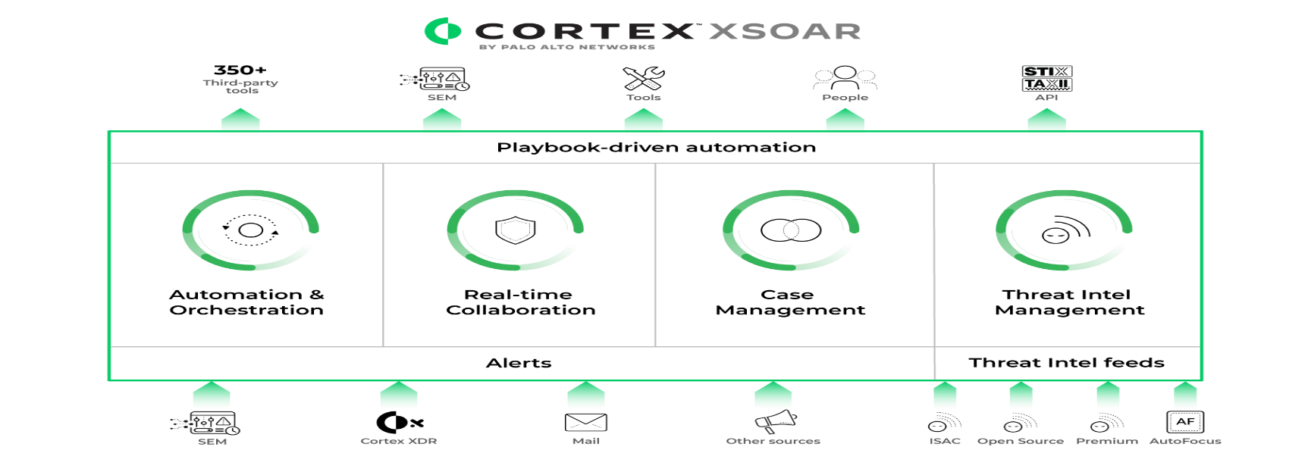
Cybersecurity virtual internship
Modules
Module 4: Security Operations Fundamentals
The Security Operations Fundamentals course offers insights into the daily responsibilities of a SecOps analyst and the six key elements of security operations. It introduces SOAR technology that streamlines and automates cybersecurity response and prevention. The course covers endpoint protection using the Cortex XDR agent, which leverages behavioral analysis and AI to stop advanced threats. It also provides an overview of Cortex XSOAR Threat Intelligence Management (TIM) for automating threat intelligence, including data sources and incident enrichment. Lastly, it introduces the Palo Alto Networks Cortex platform, which includes Cortex XSOAR, Cortex XDR, Cortex XSOAR TIM, and Cortex XSIAM for comprehensive security operations.
224G1A3324
DEPT.OF CSE(AI&ML)
Srinivasa Ramanujan Institute of Technology
10

Slide 11
Cybersecurity virtual internship
Learning Outcomes
Learning Outcomes from the Palo Alto Cybersecurity Virtual Internship:
Understanding of Cybersecurity Landscape: Gain insights into the evolving nature of cyber threats and modern attack techniques.
Network Security Fundamentals: Learn about network protection strategies, including firewalls, IP addressing, and secure network models.
Endpoint Security: Acquire knowledge on securing endpoints against malware, phishing, ransomware, and other advanced threats.
Zero Trust Security Model: Understand the principles of Zero Trust and perimeter-based security models for robust network defense.
SOAR and Threat Intelligence: Learn to automate and streamline threat detection and response processes using SOAR and Cortex XSOAR platforms.
Cloud Security Best Practices: Explore cloud-native security solutions with Prisma Cloud and learn about cloud security operations.
Hands-on Experience with Palo Alto Networks Tools: Get familiar with tools like Cortex XDR, Cortex XSOAR, and Prisma Cloud for managing real-world cybersecurity threats.
Comprehensive Threat Prevention Strategies: Understand integrated security measures for threat prevention, detection, and incident response.
224G1A3324
DEPT.OF CSE(AI&ML)
Srinivasa Ramanujan Institute of Technology
5

Slide 12
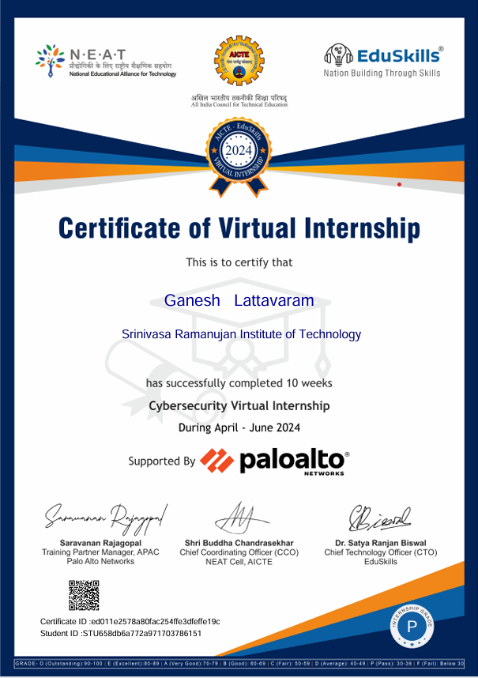
Cybersecurity virtual internship
Certificate
224G1A3324
DEPT.OF CSE(AI&ML)
Srinivasa Ramanujan Institute of Technology
5

